Slide 1


Slide 2


Comparing apples with apples
How to get great responses to your Request for Proposal
An webinar with

Slide 3








What we’ll cover…
Recipe for success
What you need to think about and who you need to
consult before you start to write your RfP
What potential suppliers need to know to provide
an effective response
How to structure your RfP for completeness and clarity
How to deal with questions
How to evaluate the responses fairly

Slide 4




So you want some training…
Recipe for success
3
Be open
to ideas
Define your training requirements before you look for solutions
Get a feel for the market and look at different options…
… and their price tags
What you want, what you need and what you can get for your budget might not necessarily be aligned…
… take advice from training professionals
Be realistic and set an appropriate budget
1
Training needs analysis
4
Budget
2
Do your
homework

Slide 5



Before you start, think about…
Recipe for success
  Have you already scoped the project, or do you need vendor guidance?
  If you don’t know how long the project should be, ask for a per-hour cost break down
  Do you have subject matter expertise or do you need this to be provided?
  Do you have any existing material that can be repurposed (eg video, photo banks)?
  Plan as far in advance as possible – try not to request a rush job at the last minute
  Be realistic with your expectations of development time – 8-12 weeks for one hour is average
1
What can you do in-house and
what needs to be outsourced?
2
When does the project
need to be completed?

Slide 6


The quality triangle…
Recipe for success
£
Cost
Quality is constrained by
cost
timelines
scope
Be realistic – a long course at low cost with a short timescale won’t be high quality.
Quality
Time
Scope

Slide 7
















Who to consult…
Recipe for success
You’ll need to share technical information with the potential
vendors
What resource is available from your side?
Will they be available during the
project and have they been briefed?
How much oversight do they need?
Payment schedules?
Contracts and procurement processes?
1
2
3
IT or technical
Project managers
Subject experts
4
5
6
Branding
Finance
Legal

Slide 8

Structuring your RfP…
Recipe for success
2
Response instructions
Introduction, purpose, needs, interactivity, technical
specification and delivery timelines
Q&A and selection timelines,
response format, scoring criteria/weighting
Sample content, brand guidelines,
legal and contractual information
1
Background information
3
Supporting resources

Slide 9













Budget…
Recipe for success
State your budget if possible
Be very clear on scope and treatment ‘level’ if budget can’t be revealed
Clarity will ensure that you receive solutions that meet your needs – enabling you to compare apples with apples.

Slide 10

Background…
Recipe for success
Complex or simple?
Game-based or gamified?
Case studies or scenarios?
Branching?
Photography?
Illustrations?
Video?
Audio?
Animation?
3D?
Learning management system? SCORM? X-API? Reporting requirements?
Accessibility?
Devices? Responsive?
Preferred development tool?
When is it required?
1
Introduction
General information about your organisation
What do you want to achieve?
Demographics?
Globally dispersed?
Alternative languages required?
Education and experience – beginners, experts of a mix?
Constraints?
Generic, bespoke, classroom, blended, resource cloud?
Long, short, bite-sized?
2
Purpose
3
Audience
4
Needs
5
Interactivity
6
Media
7
Tech spec
8
Timelines

Slide 11

Response…
Recipe for success
Giving questions to answer, headings/areas to complete or
a general template helps make
sure you can compare apples
with apples
Word count or page count, or
no restriction?
Cost matrix – make it granular and consistent (eg per hour, specifying treatment levels)
Ask for a training solution
unless it’s a quick quote
What’s most important to you? Make this clear to vendors so they provide you with comparable answers.
Make scoring transparent so all vendors direct their answers accordingly
  Make sure timelines for response and evaluation reflect the amount of detail required in your response
  Include dates and rules for Q&A – for both receiving questions, and supplying your answers
  Give plenty of time for vendors to complete their responses after questions and answers have been circulated
  If you want to ask shortlisted suppliers to present, give them sufficient notice of when and what you want them to do
1
Timelines
2
Format
3
Evaluation

Slide 12



Resources…
Recipe for success
2
Brand guidelines
Give vendors a sample to work
with so you can compare like
with like
Provide as much access to existing material as possible so vendors understand the context
Don’t make vendors contact you to
ask for these – include them in your RfP or make it clear you are looking
for a unique new brand for the
product
Sample contracts and general requirements will assist vendors and speed up the process later on. Beware
of cutting and pasting.
1
Sample content
3
Legal information

Slide 13

Reviewing the responses…
If you’ve included the recommended information you should receive a range of solutions that:
Are of a similar duration and complexity
Fit your budget
Meet your technical
requirements
You can now compare creativity, design, process and vendor profile – ie the things that really matter

Slide 14
Summary…
Recipe for success
Do your homework before you start
Set and work to a budget
Provide detailed information about your requirement
Give suppliers time to ask questions
Be transparent with your evaluation

Slide 15

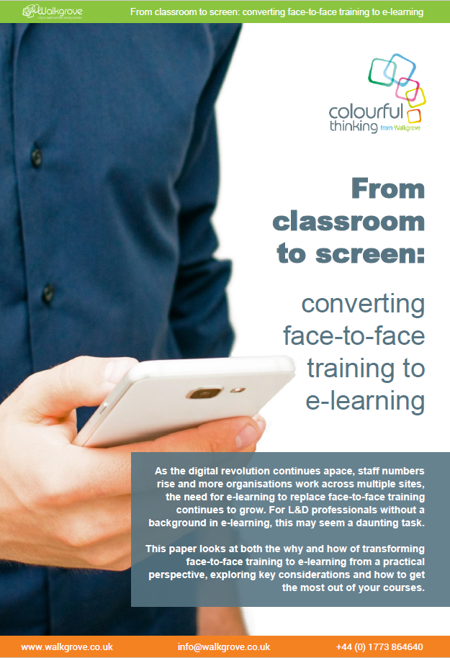





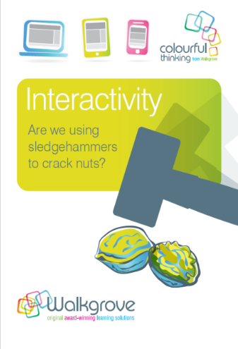
Thank you for your time
Why not download our white papers and other resources at
www.walkgrove.co.uk/colourful-thinking/resources

